Slide 1
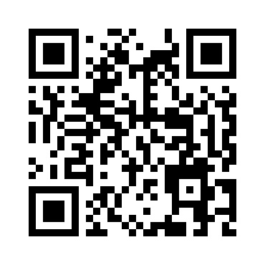
HDMapping v0.92
MapsHD/HDMapping
januszbedkowski@gmail.com

Slide 2
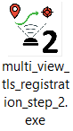
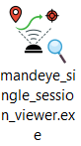
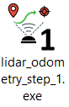
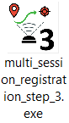
Workflow diagram
Ground truth session
QC
Data collection
mandeye_raw_data_viewer
QC
Data publication (LAZ)

Slide 3
Assumptions:
1. Project is composed of multiple sessions
2. Only one session in the project can be „ground truth”
3. multi_session_registration_step_3.exe perfroms pose graph slam
4. It is possible to add Edge for single session (similar to multi_view_tls_registration_step_2.exe)
5. It is possible to add Edge for two different sessions
6. „Ground truth” can not be changed (gizmo is disabled), only multi_view_tls_registration_step_2.exe can change „Ground truth” flag

Slide 4
IMU versus LiDAR inertial odometry error quality check

Slide 5
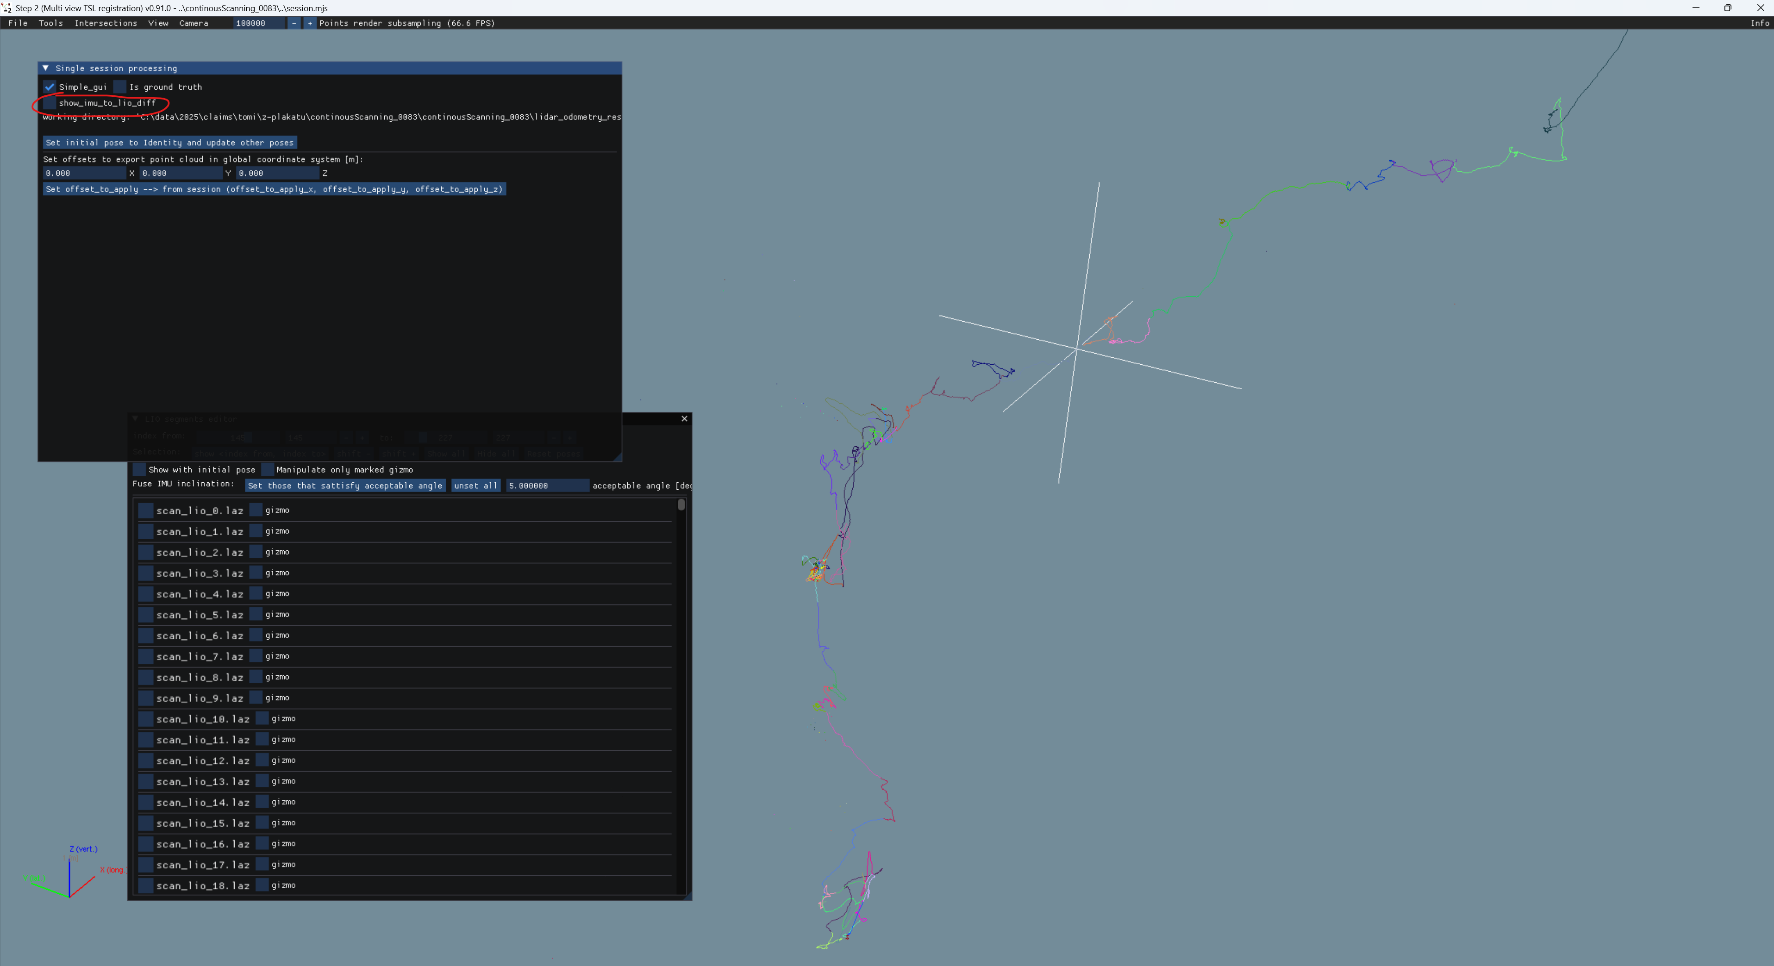
After session load in step2, use show_imu_to_lio_diff to check for large differences between LiDAR and IMU estimations

Slide 6


Slide 7
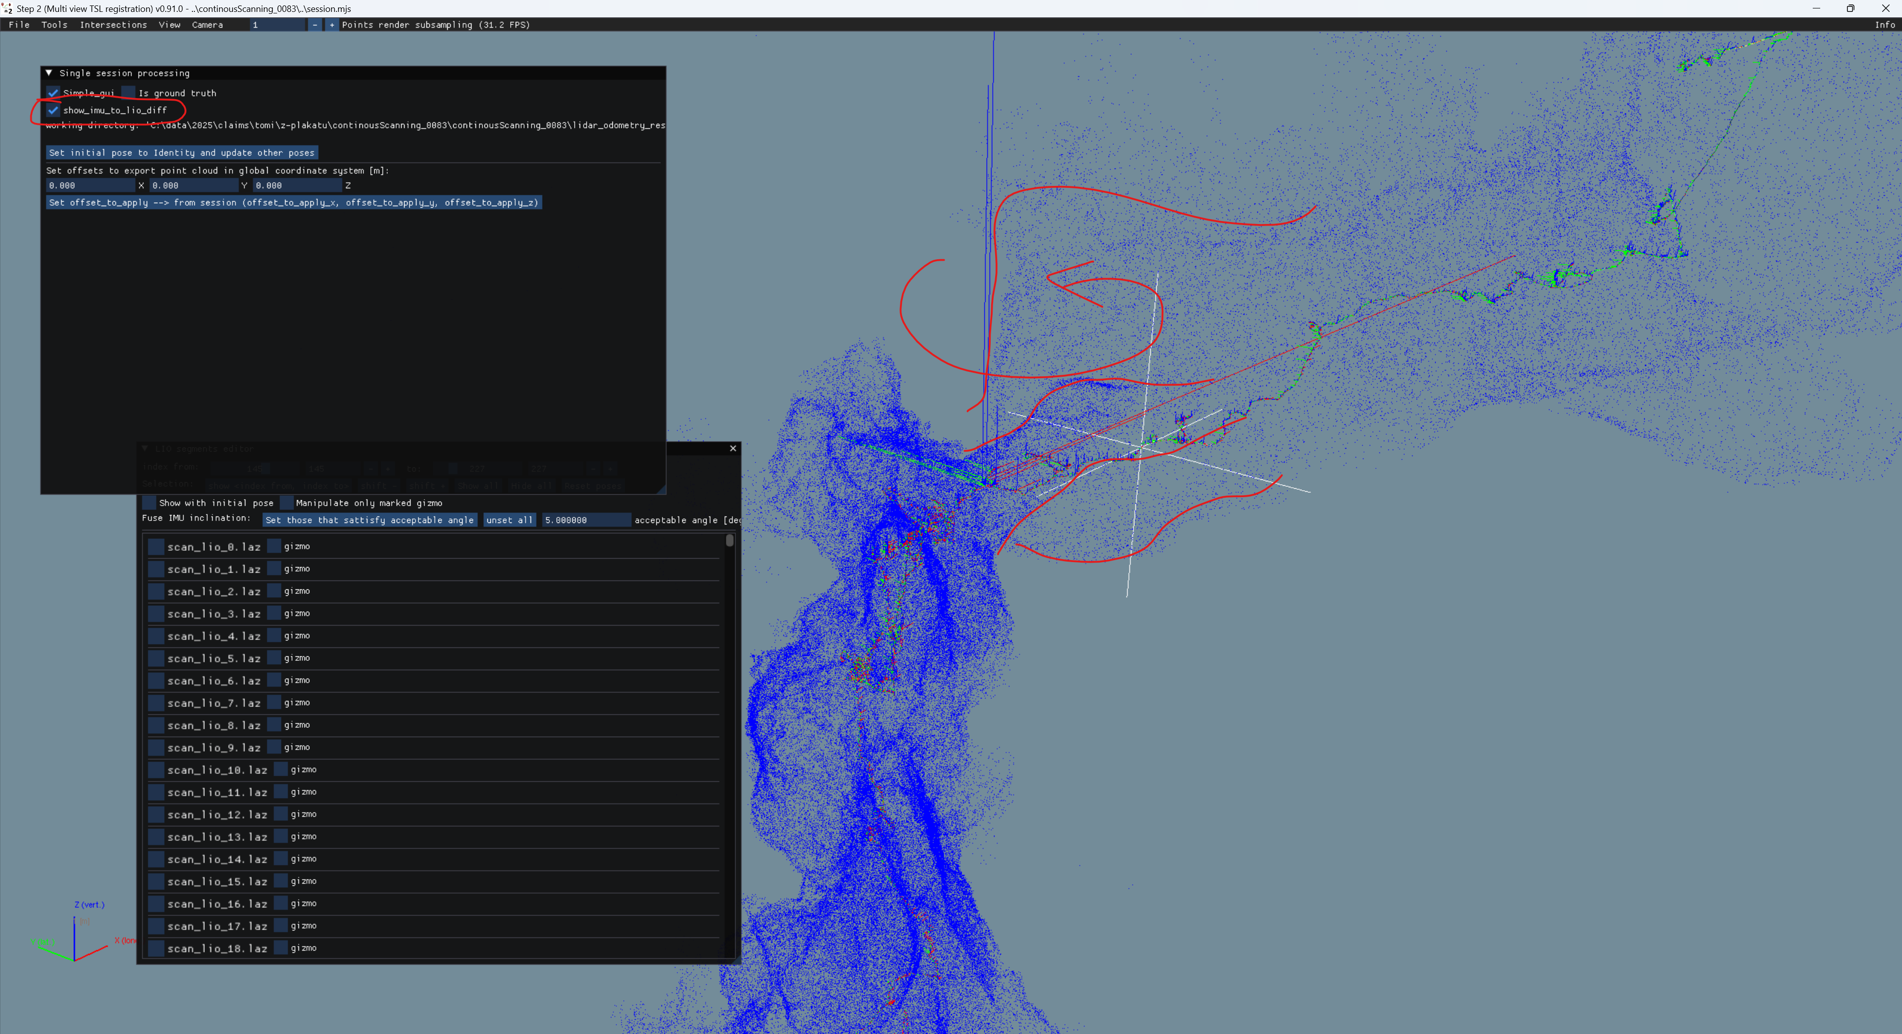
WHAT IS SHOWN HERE???

Slide 8
Georeferencing to ground truth point cloud

Slide 9
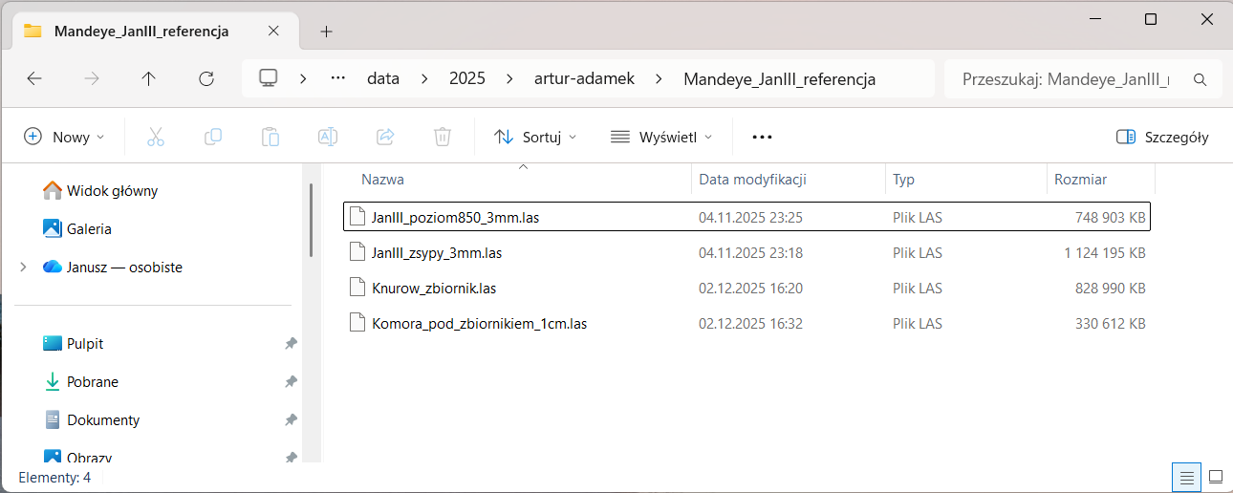
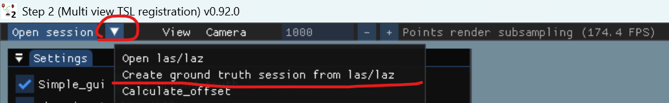
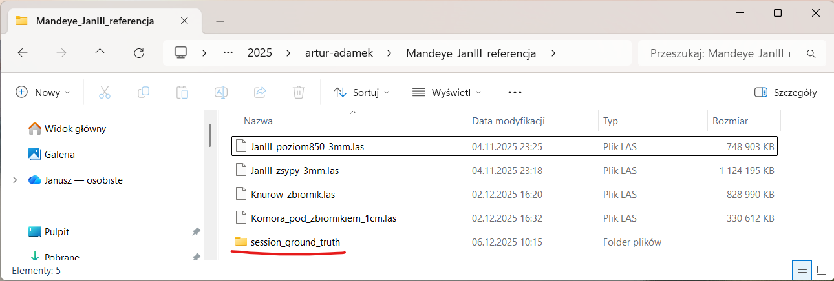
Creating ground truth session from point clouds
1. Using multi_view_tls_registration_step_2.exe
collect ground truth point clouds (laz/las) in one folder
2. Click in menu Create ground truth session from las/laz
3. New session_ground_truth will appear -> use it in step3

Slide 10
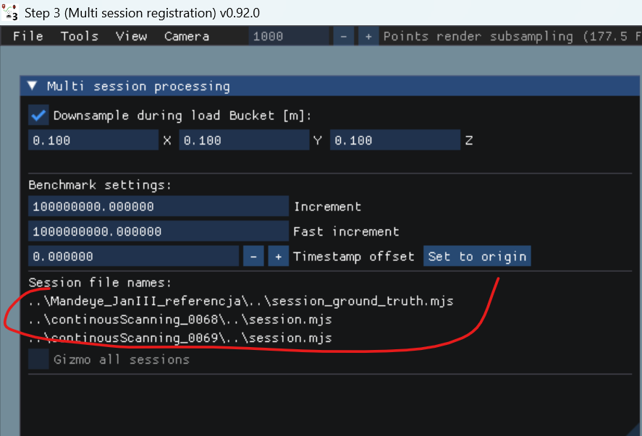
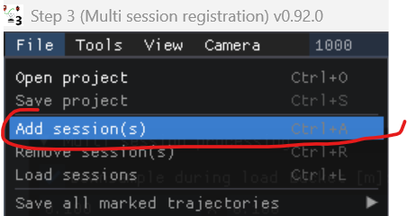
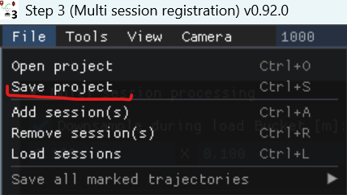
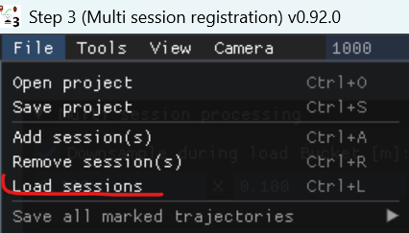
Creating multi session project
1. using multi_session_registration_step_3.exe add session to project
2. Save project
3. Load sessions

Slide 11
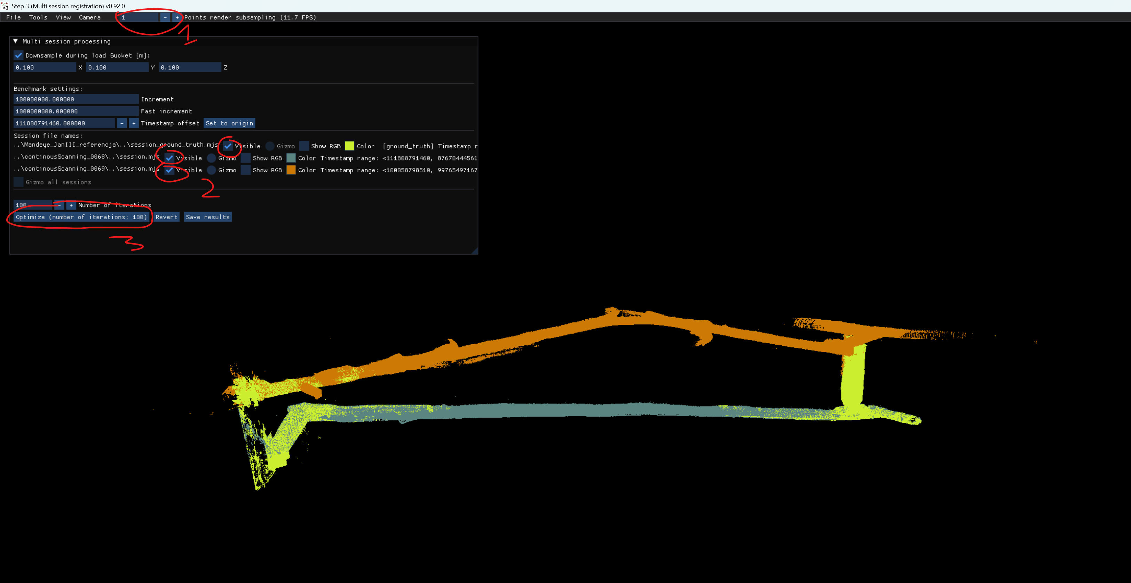
Multi session project – important GUIs
1. downsample point cloud
2. sect sessions to work with (select 1 to work like in step2, select 2 to add Edge between two sessions)
3. select 3 to apply pose graph slam

Slide 12
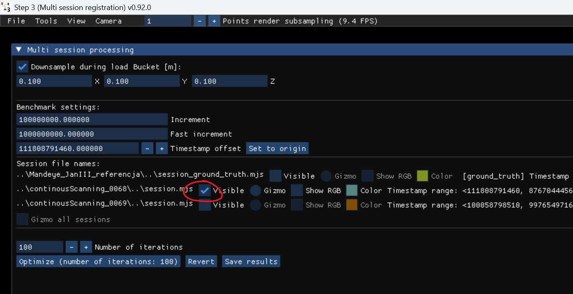
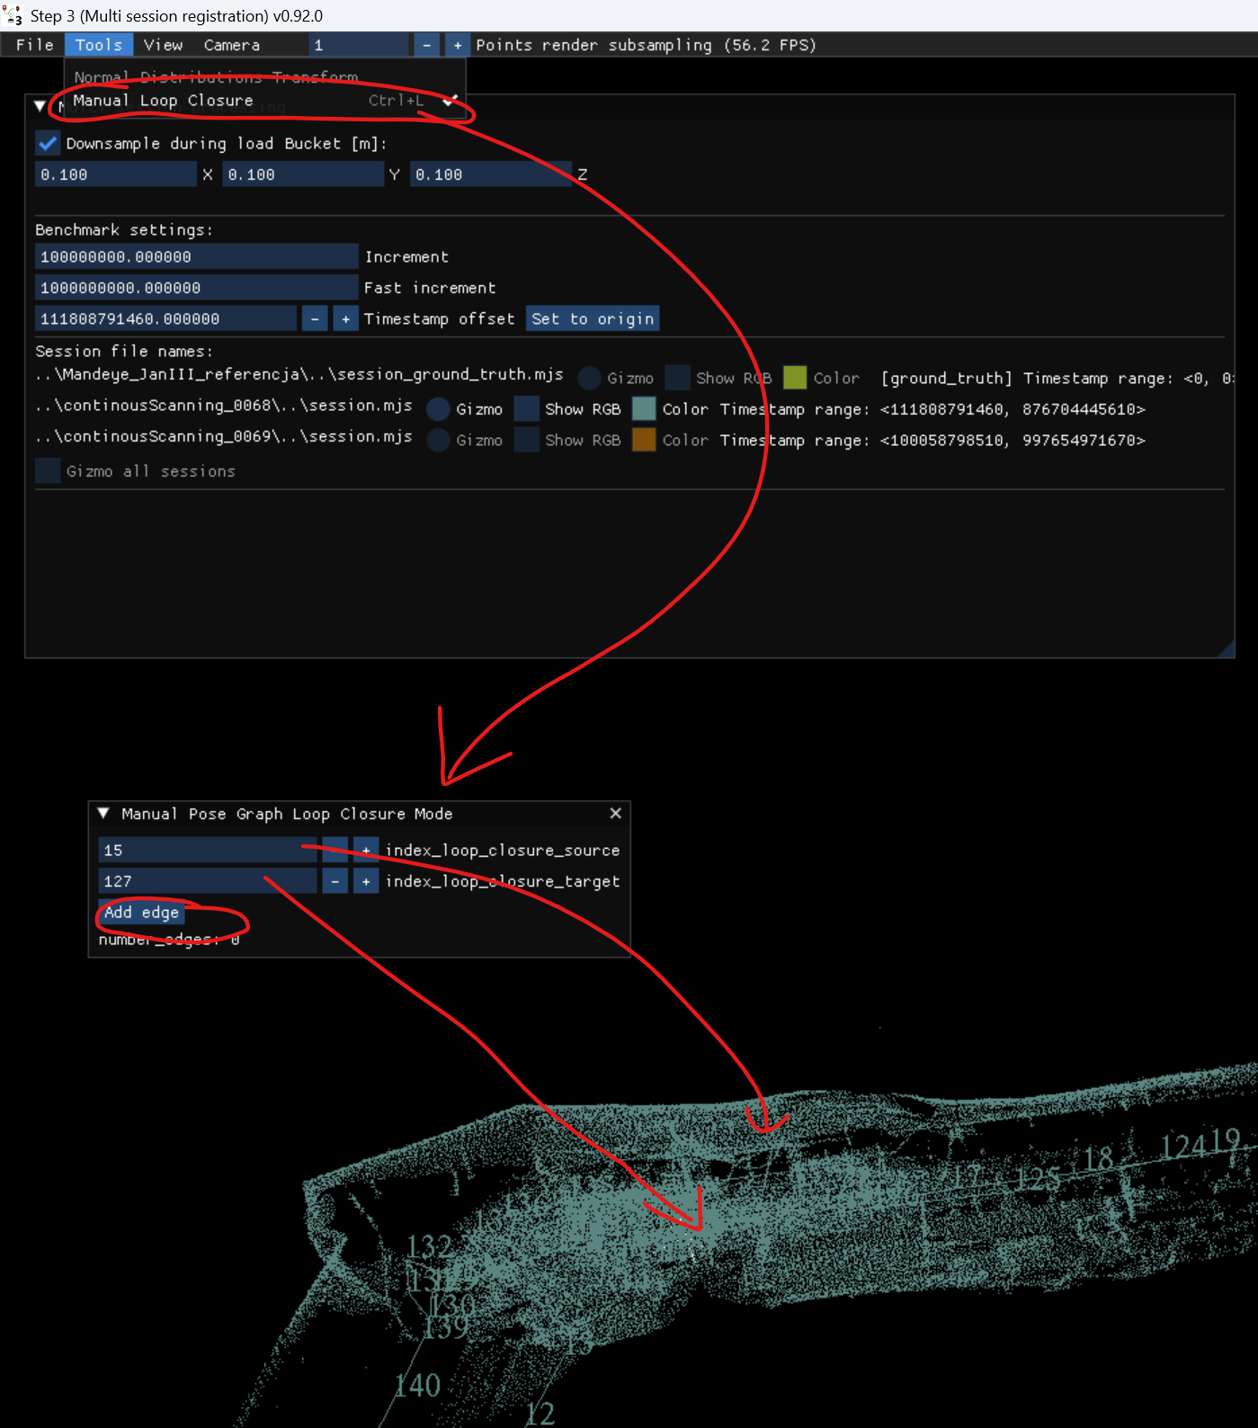
Multi session project – create edge for single point cloud
1. Select 1 session
2. Select Manual Loop Closure
3. Choose 2 nodes
4. Click Add Edge

Slide 13
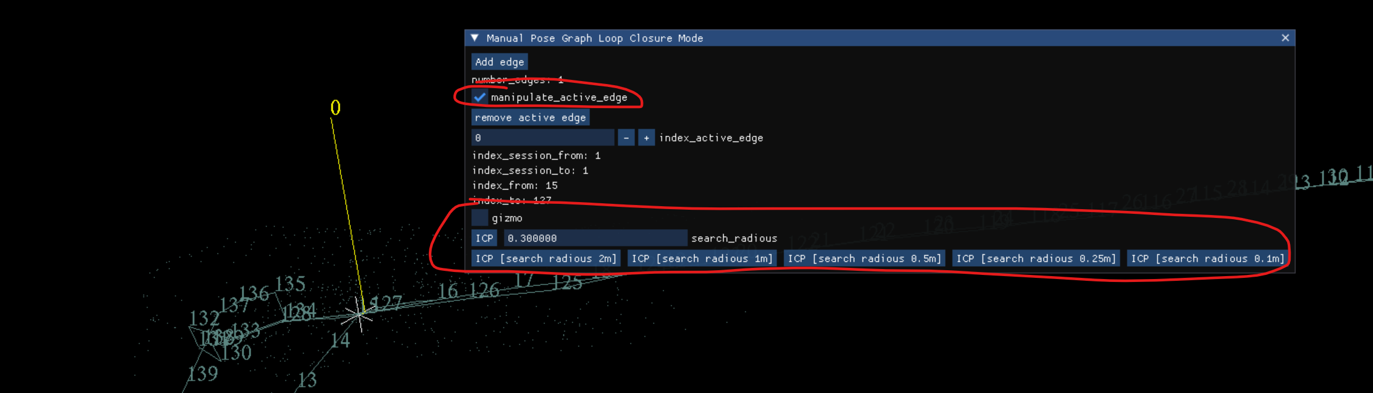
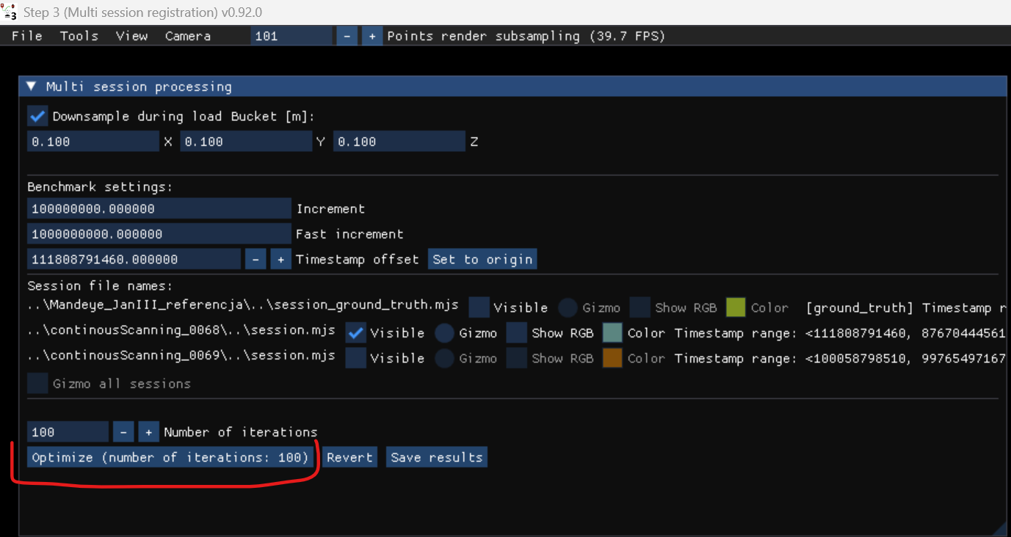
Multi session project – create edge
1. Select manipulate_active_edge
2. Use ICP to align two point clouds
3. Aplly pose graph slam

Slide 14
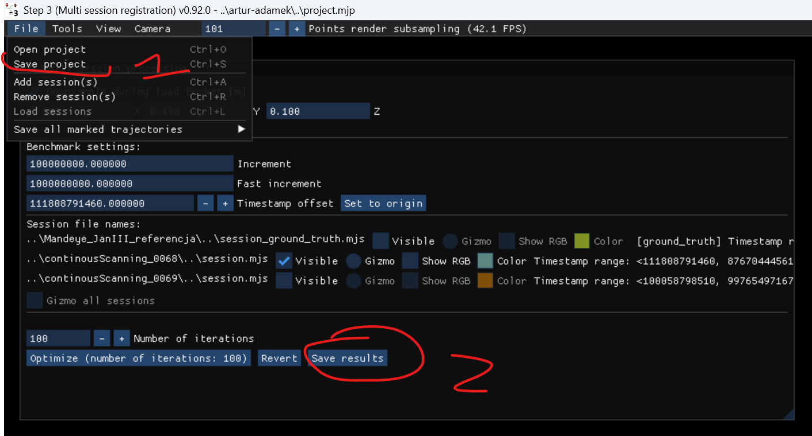
Creating multi session project – save intermediate results
1. Each time you add edge it is advised to save results (two steps)

Slide 15
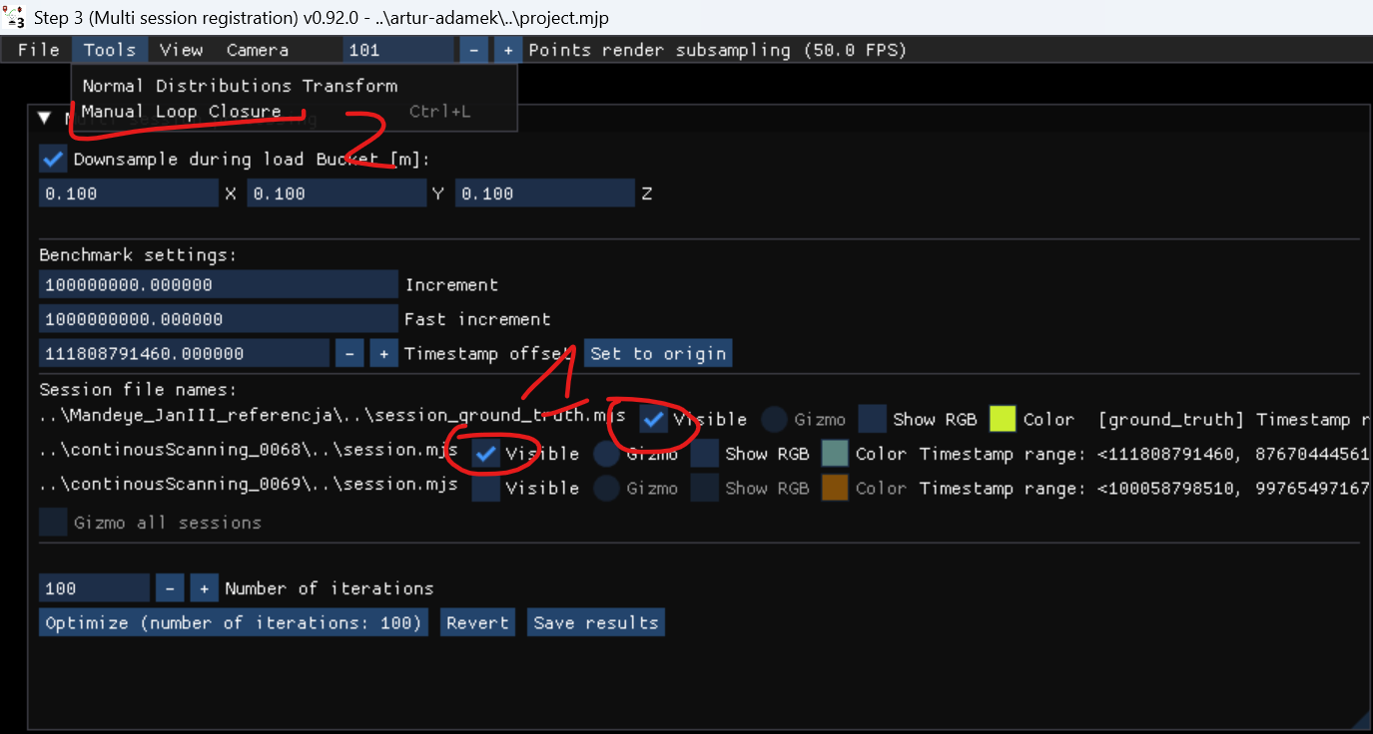
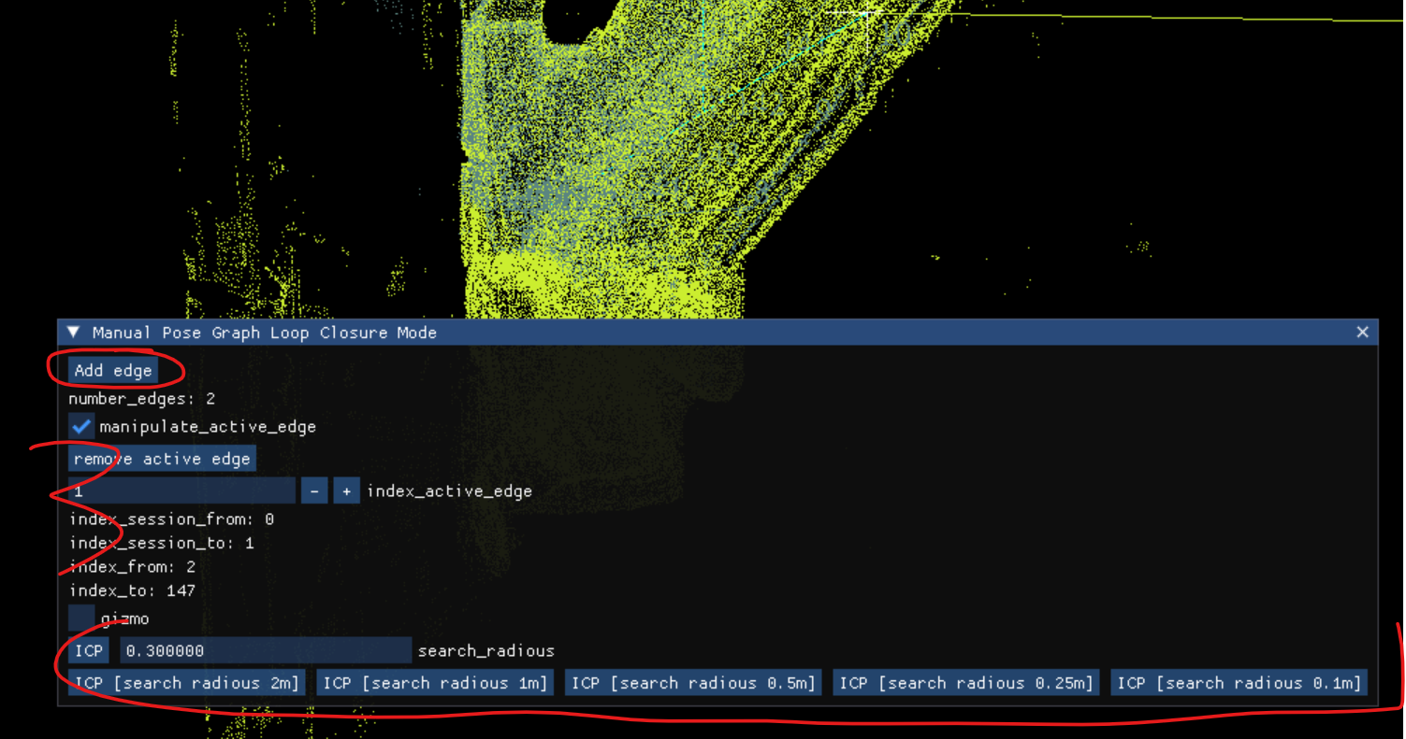
Creating multi session project – create edge for two point clouds
1. Select two point clouds
2. Select Manual Loop Closure
3. Add Edge and use ICP to align two point clouds

Slide 16
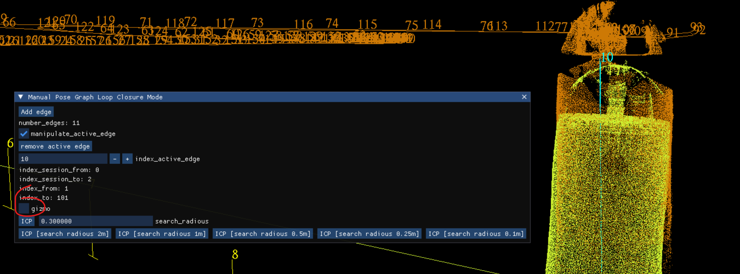
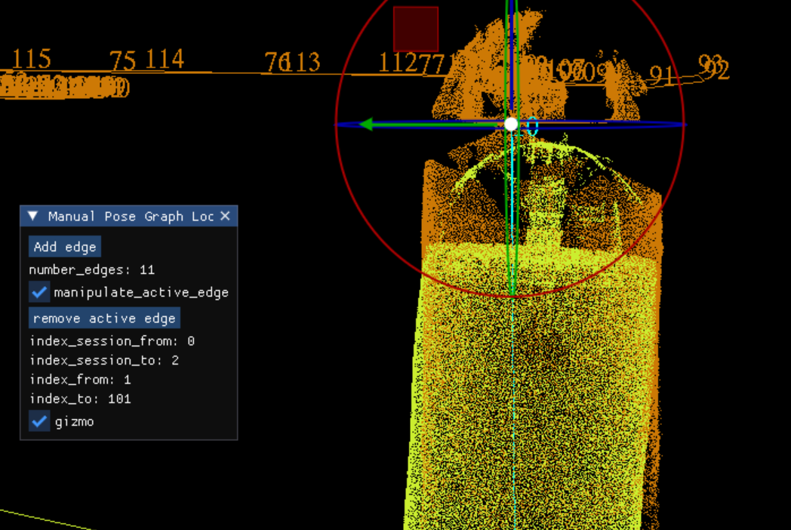
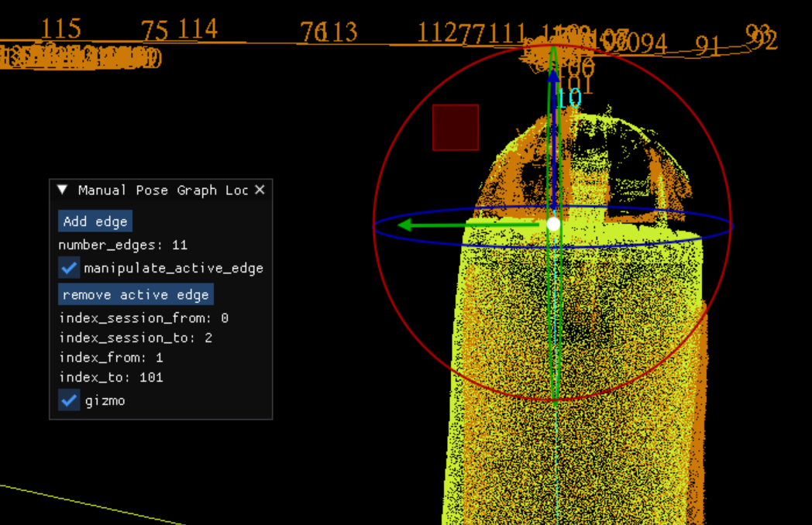
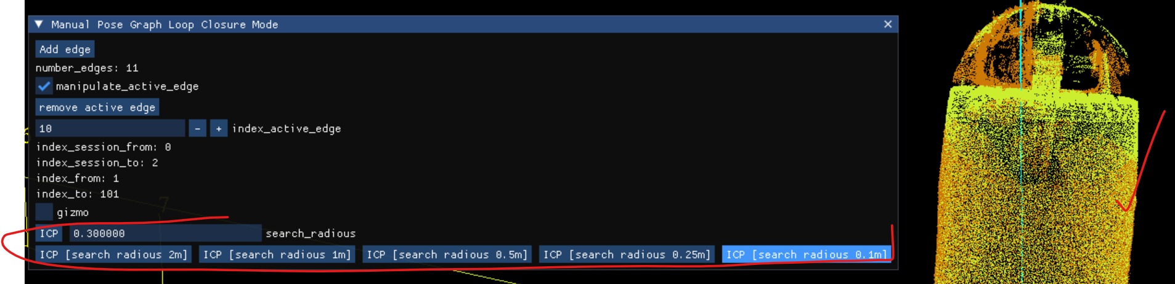
Creating multi session project – manual edge alignment with gizmo
1. Use gizmo to align manually if necessary, finally ICP

Slide 17
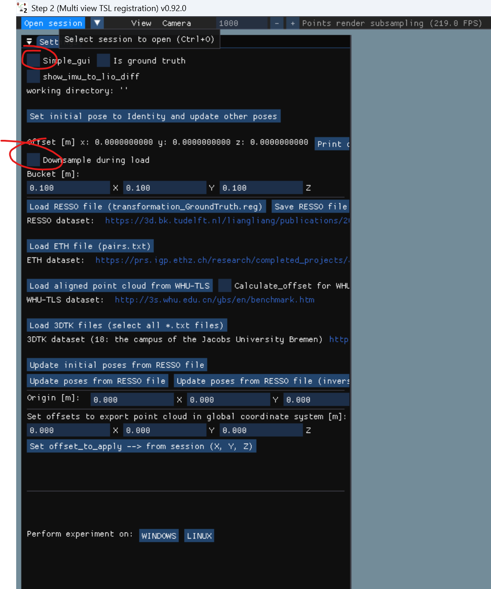
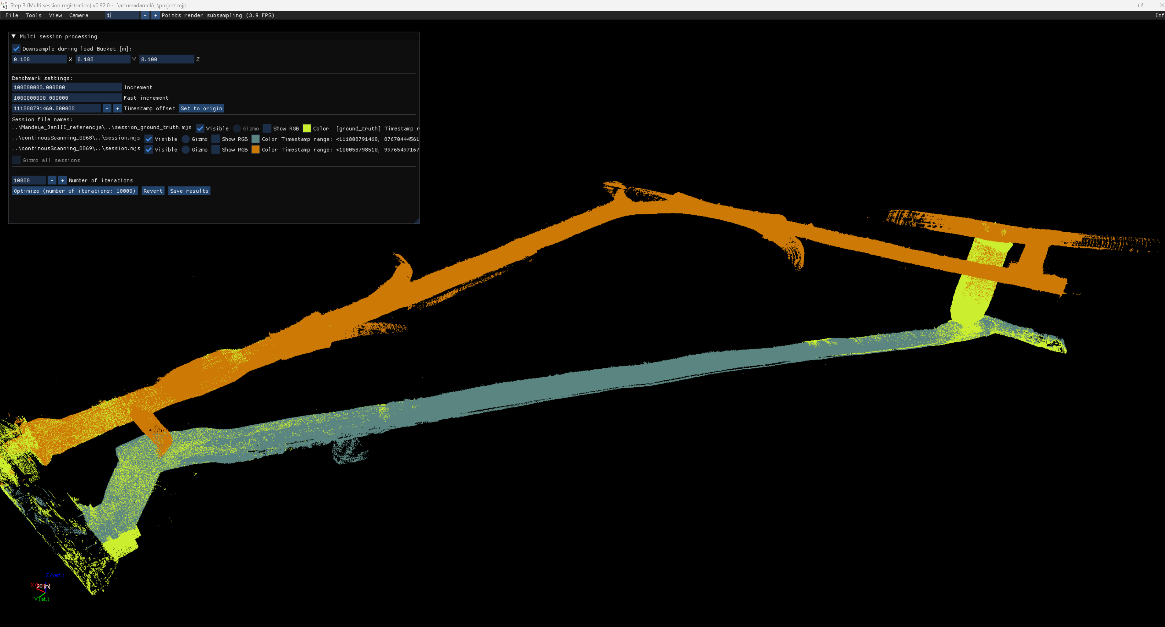
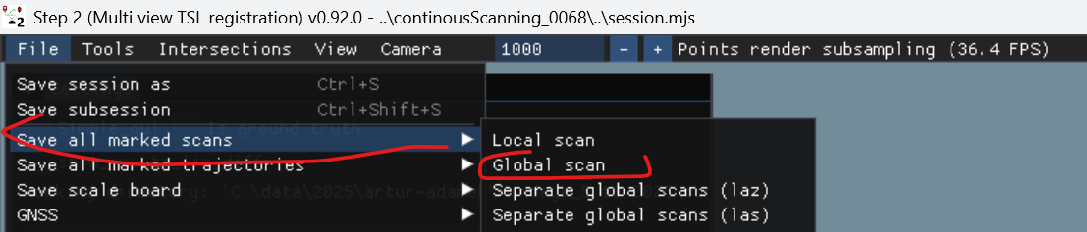
Multi session project - final step
1. Publish data using multi_view_tls_registration_step_2.exe (remember to unmark ‚downsample durig load’)

Slide 18
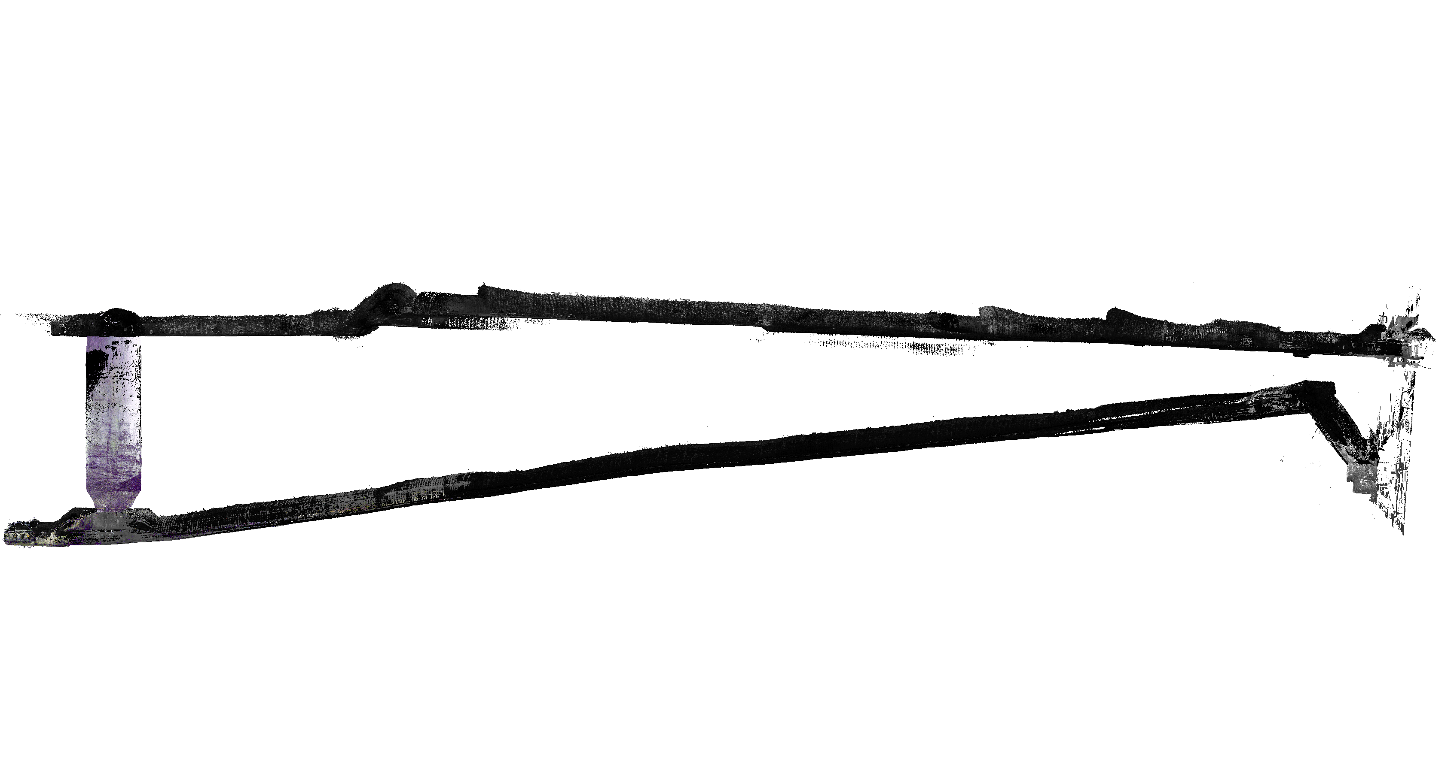
Multi session project - inspect data in CloudCompare

Slide 19
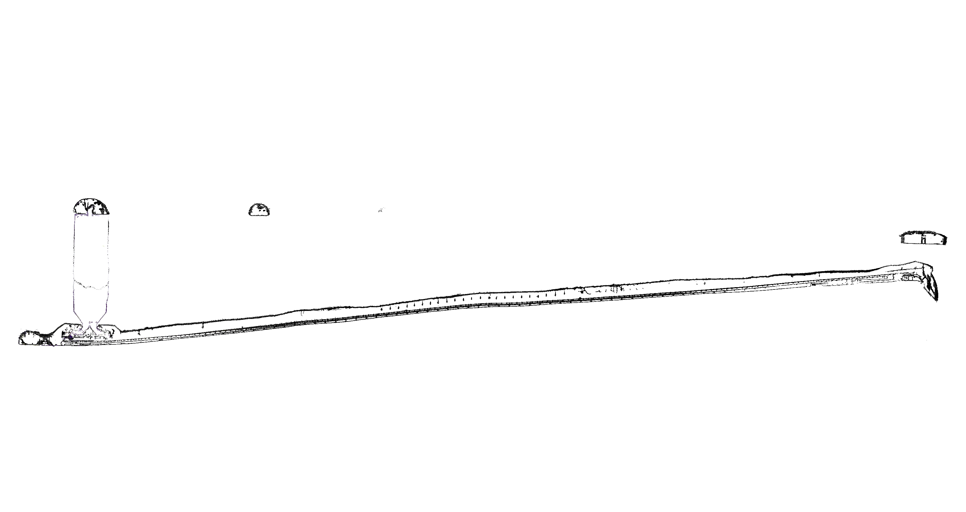
Multi session project - inspect data in CloudCompare

Slide 20
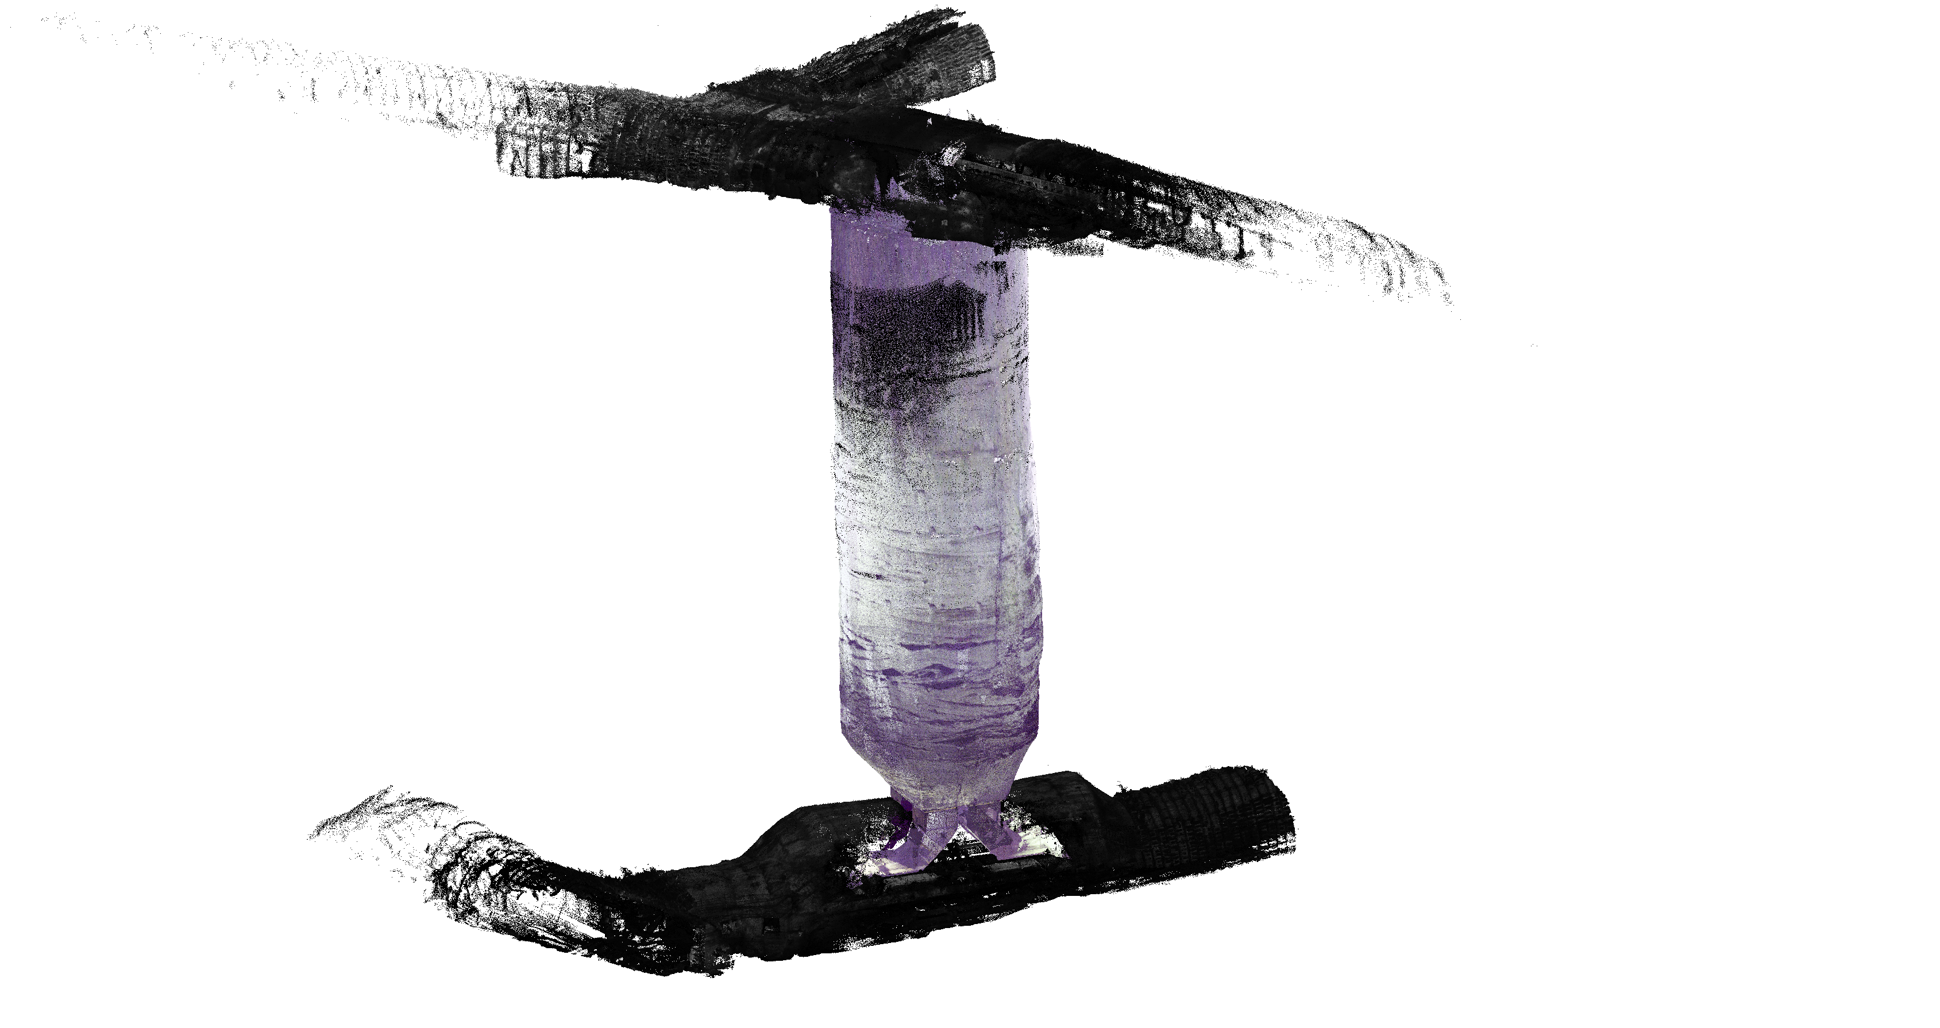
Multi session project - inspect data in CloudCompare

Slide 21
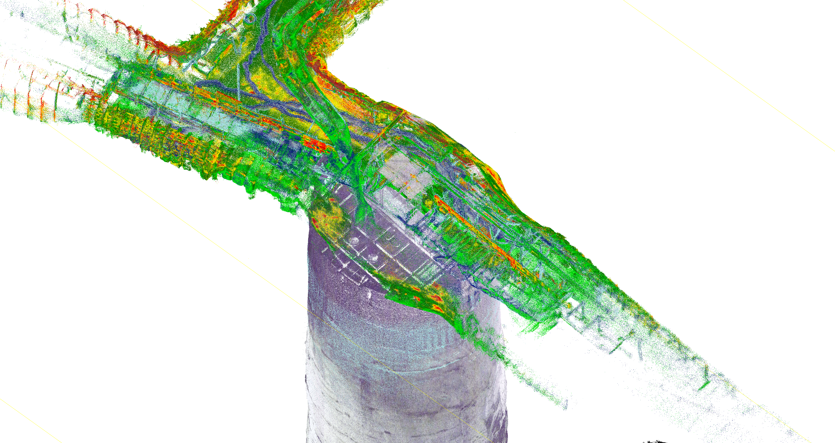
Multi session project - inspect data in CloudCompare

